Slide 1
Introduction to Computer Simulation of Physical Systems (Lecture 5) Simulating Particle Motion (CONTINUED)
PHYS 3061

Slide 2
computation of the accelerations of the particles.
The most time consuming part of MD.
The method computeAcceleration determines the total force on each particle
due to the other N −1 particles
uses Newton’s third law to reduce the number of calculations by a factor of two.

Slide 3
For a system of N particles, there are a total of N(N −1)/2 possible interactions.
Because of the short range nature of the Lennard-Jones potential, we could truncate the force at r = rc and ignore the forces from particles whose separation is greater than rc.
However, for N < 400, it is easier to include all possible interactions, no matter how small.

Slide 4
The quantity virial accumulated in computeAcceleration will be discussed later,
We will see that it is related to the pressure.
It is convenient to also calculate the potential energy in computeAcceleration.
Note that in reduced units, the mass of a particle is unity, and hence the acceleration and force are equivalent.

Slide 5
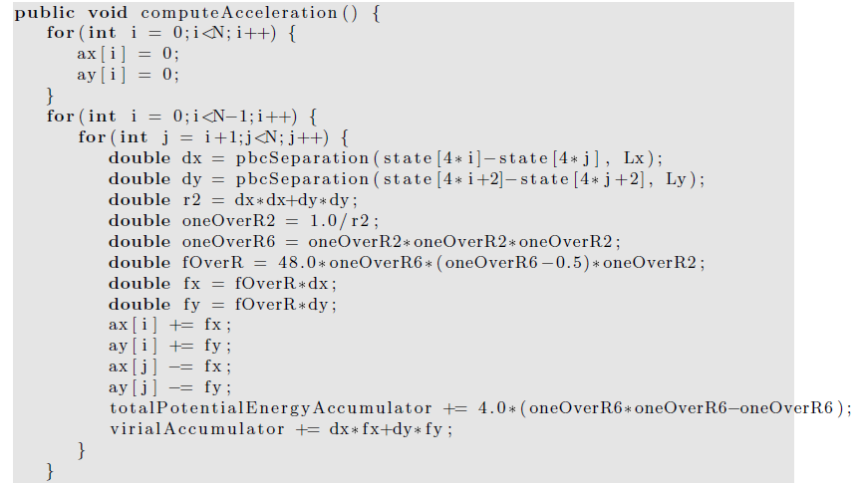
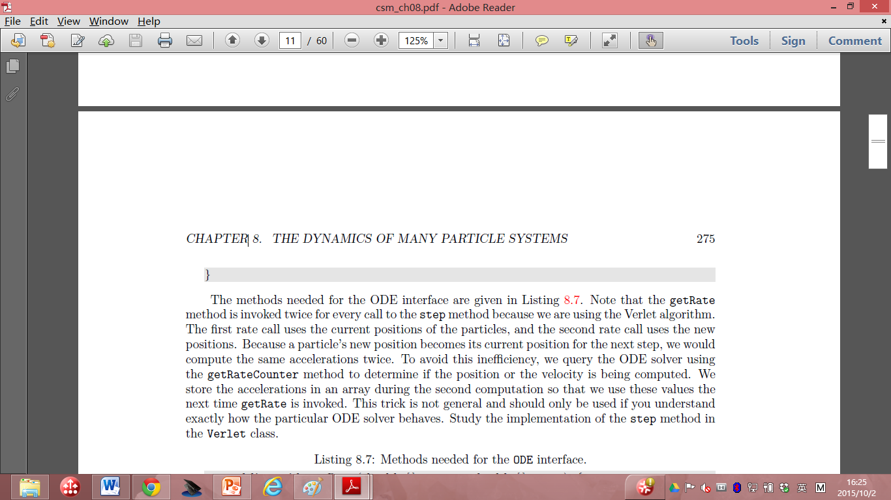

Slide 6
The methods needed for the ODE interface are given in next few pages.
Note that the getRate method is invoked twice for every call to the step method because we are using the Verlet algorithm.
The first rate call uses the current positions of the particles, and the second rate call uses the new positions.

Slide 7
Because a particle’s new position becomes its current position for the next step, we would compute the same accelerations twice in Verlet.
Any solutions?

Slide 8
To avoid this inefficiency, we query the ODE solver using the getRateCounter method to determine if the position or the velocity is being computed.
We store the accelerations in an array during the second computation so that we use these values the next time getRate is invoked.
This trick is not general and should only be used if you understand exactly how the particular ODE solver behaves.

Slide 9
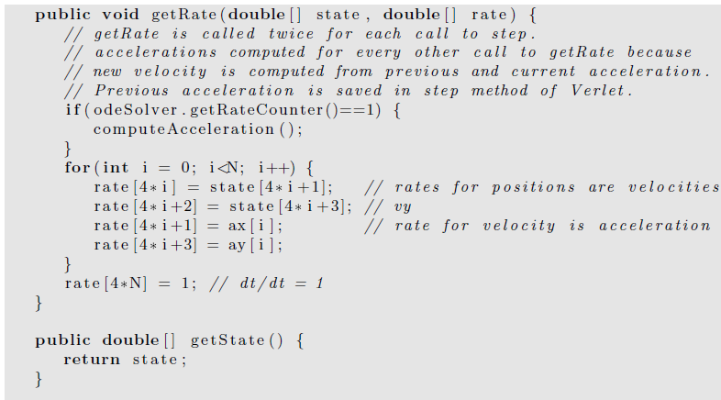

Slide 10
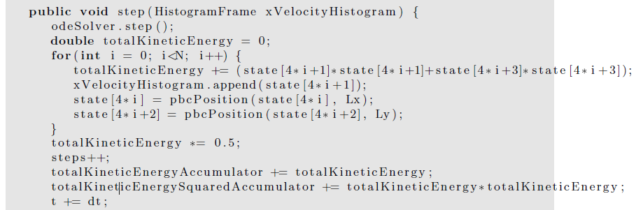
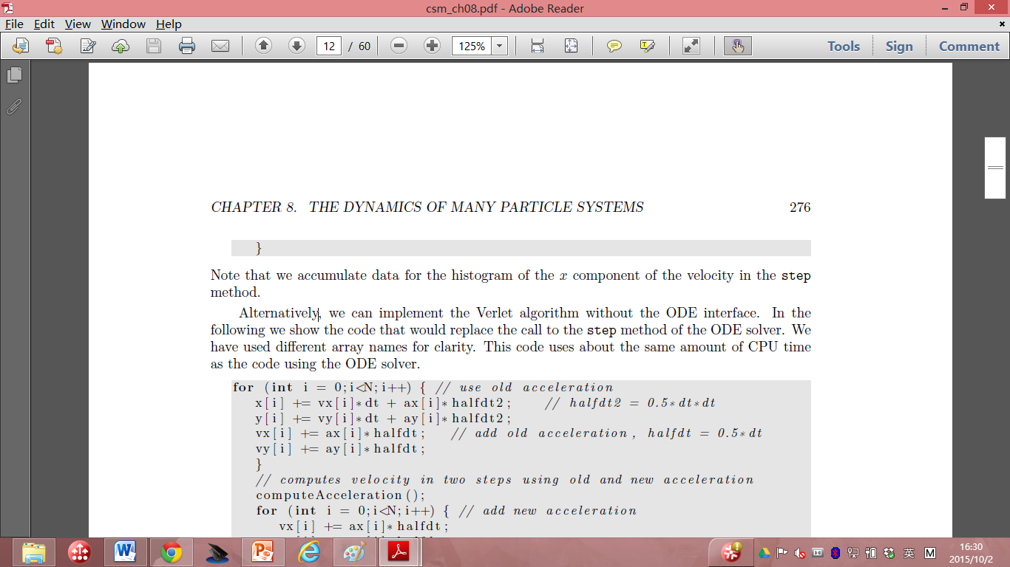

Slide 11
Note that we accumulate data for the histogram of the x component of the velocity in the step method.
Alternatively, we can implement the Verlet algorithm without the ODE interface.
In the following we show the code that would replace the call to the step method of the ODE solver.
We have used different array names for clarity.
This code uses about the same amount of CPU time as the code using the ODE solver.

Slide 12
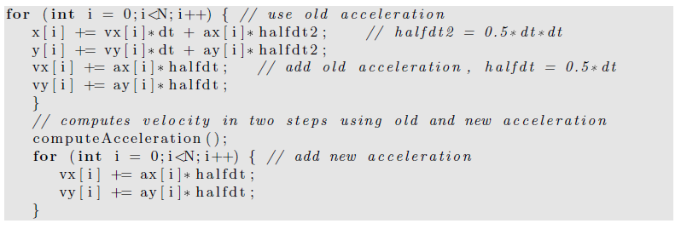
In next page, we give some of the methods for computing the temperature, pressure (details will be covered later), and the heat capacity (also covered later).
The mean total energy should remain constant, but we compute it to test how well the algorithm conserves the total energy.

Slide 13
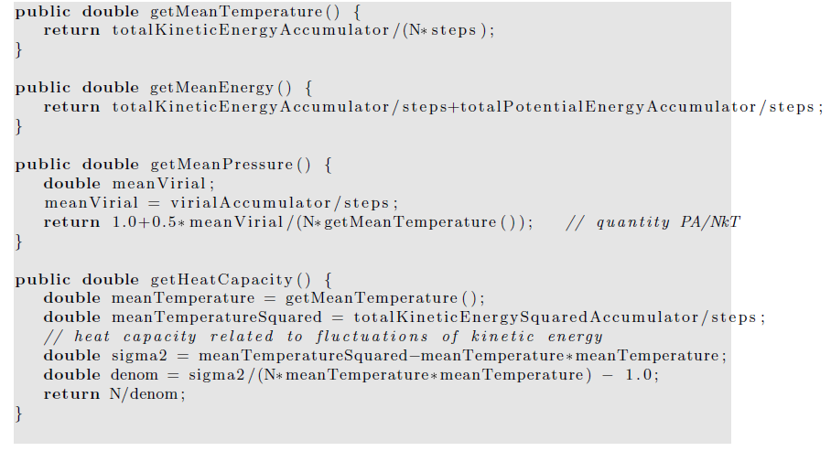

Slide 14
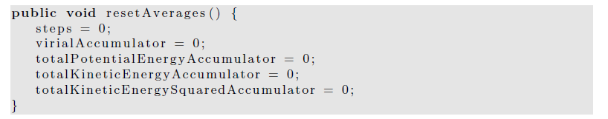
The resetAverages method is used to set the accumulated averages to zero so that the initial transient behavior can be removed from the computed averages.

Slide 15
a time consuming part of a molecular dynamics simulation is equilibrating the system, especially at high densities.
The quickest way to do so is to start with a configuration that is typical of the configurations at the desired energy and density.

Slide 16
Hence, we will want to be able to read the positions and velocities of the particles from a previously saved file.
For the GUI code, please read the text book if you are interested.

Slide 17
Thermodynamic Quantities
In the following we discuss how some of the macroscopic quantities of interest such as the temperature and the pressure can be related to time averages over the phase space trajectories of the particles.

Slide 18
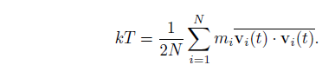
We have already introduced the definition of the kinetic temperature.
The temperature that we measure in a laboratory experiment is the mean temperature, which corresponds to the time average of T(t) over many configurations of the particles.
For two dimensions (d = 2), we write the mean temperature T as

Slide 19
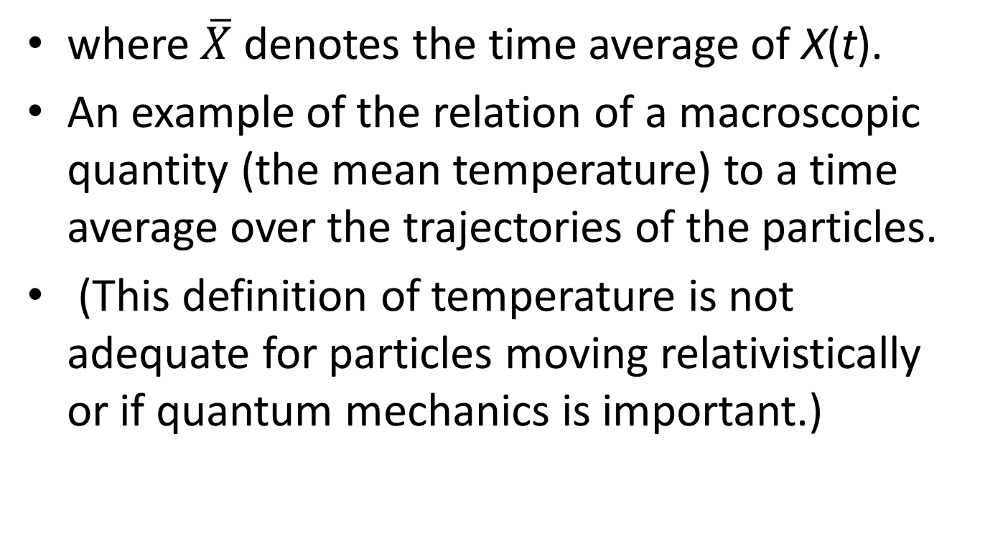
where $\overline{X}$ denotes the time average of X(t).
An example of the relation of a macroscopic quantity (the mean temperature) to a time average over the trajectories of the particles.
(This definition of temperature is not adequate for particles moving relativistically or if quantum mechanics is important.)

Slide 20
The relation holds
only if the momentum of the center of mass of the system is zero!
we do not want the motion of the center of mass to change the temperature.
In a laboratory system the walls of the container ensure that the center of mass motion is zero

Slide 21
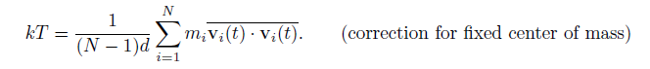
(if the mean momentum of the walls is zero).
In our simulation, we impose the constraint that the center of mass momentum (in each of the d directions) be zero.
Consequently, the system has dN − d independent velocity components rather than dN components, and we should replace the equation by

Slide 22
The presence of the factor (N −1)d rather than Nd is an example of a finite size correction that becomes unimportant for large N.
Another macroscopic quantity of interest is the mean pressure.
The pressure is related to the force per unit area normal to an imaginary surface in the system.
By Newton’s second law, this force is related to the momentum that crosses the surface per unit time.

Slide 23
We could use this relation to determine the pressure, but this relation uses information only from the fraction of particles that are crossing an arbitrary surface at a given time.
Instead, we will use the relation of the pressure to the virial , which involves all the particles in the system.

Slide 24
In general, the momentum flux across a surface has two contributions.
The contribution, NkT/V , where V is the volume (area) of the system, is due to the motion of the particles and is derived in many texts using simple kinetic theory arguments.

Slide 25
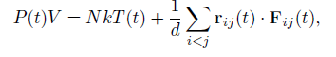
The other contribution to the momentum flux arises from the momentum transferred across the surface due to the forces between particles on different sides of the surface.
It can be shown that the instantaneous pressure at time t including both contributions to the momentum flux is given by

Slide 26
where r_{ij} = r_{i} − r_{j} and F_{ij} is the force on particle i due to particle j.
The second term is related to the virial and represents the correction to the ideal gas equation of state due to the interactions between the particles.
(In two and one dimensions, we replace V by the area and length, respectively.)

Slide 27
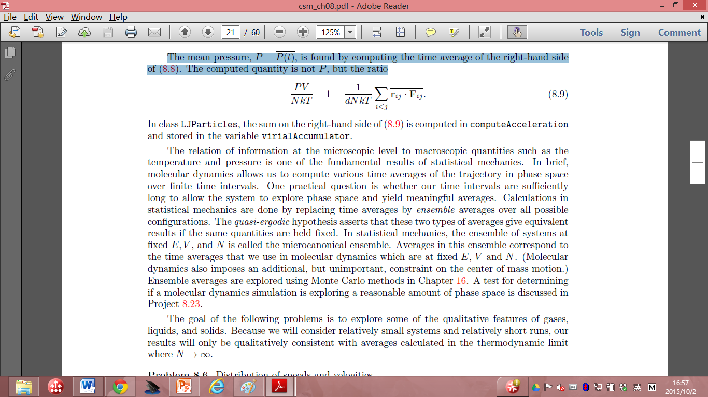
The mean pressure, P = P(t), is found by computing the time average of the right-hand side of the above equation.
The computed quantity is not P, but the ratio

Slide 28
The mean pressure, P = P(t), is found by computing the time average of the right-hand side of the above equation.
The computed quantity is not P, but the ratio

Slide 29
The relation of information
at the microscopic level to macroscopic quantities
such as: the temperature and pressure
one of the fundamental results of statistical mechanics.
In brief, molecular dynamics
allows us to compute various time averages of the trajectory
in phase space over finite time intervals.

Slide 30
One practical question:
whether our time intervals are sufficiently long to allow the system to explore phase space and yield meaningful averages?
Calculations in statistical mechanics are done by replacing time averages by ensemble averages over all possible configurations.

Slide 31
The quasi-ergodic hypothesis asserts that these two types of averages give equivalent results if the same quantities are held fixed.
In statistical mechanics, the ensemble of systems at fixed E, V , and N is called the microcanonical ensemble.

Slide 32
Averages in this ensemble correspond to the time averages
that we use in molecular dynamics
at fixed E, V and N.
(Molecular dynamics also imposes an additional, but unimportant, constraint on the center of mass motion.)

Slide 33
Another useful thermal quantity is the heat capacity at constant volume,
defined by the relation C_{V} = (∂E/∂T)_{V} .
(The subscript V denotes that the partial derivative is taken with the volume held fixed.)
C_{V} : an example of a linear response function
the response of the temperature to a change in the energy of the system.

Slide 34
One way to obtain C_{V} is to determine T(E),
the temperature as a function of E.
(Remember that a molecular dynamics simulation yields T as a function of E.)
The heat capacity is given approximately by ΔE/ΔT for two runs that have slightly different temperatures.
This method is straightforward, but requires that simulations at different energies be done.

Slide 35

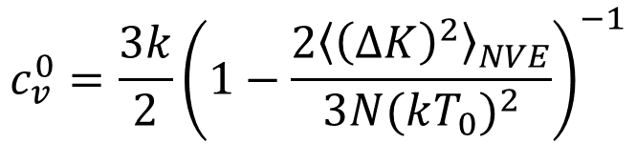
C_{V} is related to the fluctuations of the total energy in the canonical ensemble in which T, V , N are held fixed.
In molecular dynamics simulations
(supposedly micro canonical ensemble),
the total energy is fixed, but the kinetic and potential energies can fluctuate.
Another way of determining C_{V} is to relate it to the fluctuations of the kinetic energy. It can be shown that
$$c_{v}^{0}=\frac{3k}{2}{\left(1−\frac{2{\left\langle {\left(∆K\right)}^{2}\right\rangle }_{NVE}}{3N{(kT_{0})}^{2}}\right)}^{−1}$$

Slide 36
Radial Distribution Function
To gain more insight into the structure of a many body system
looking at how the positions of the particles are correlated with one another due to their interactions.

Slide 37
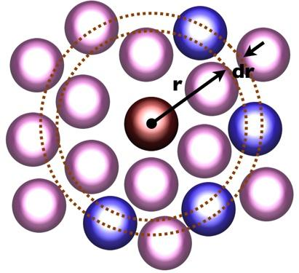
The radial distribution function g(r): a measure of this correlation and has the following properties:
Suppose that N particles are in a region of volume V with number density ρ = N/V .
Choose one of the particles to be the origin.
Then the mean number of other particles between r and r + dr is defined to be ρg(r) dr.
If the interparticle interaction is spherically symmetric and the system is a gas or a liquid, then g(r) depends only on the separation r = |r|.

Slide 38
The normalization condition for g(r) is
ρ∫g(r) dr = N − 1 ≈ N,
the volume element dr = 4πr²dr (d = 3), 2πrdr (d = 2), and 2dr (d = 1).
if we choose one particle as the origin and count all the other particles in the system, we obtain N − 1 particles.
Question, what’s the g(r) for ideal gas?
What’s the g(r) for LJ potential?

Slide 39
For an ideal gas, there are no correlations between the particles, and the normalization condition implies that g(r) = 1 for all r.
For the Lennard-Jones interaction, we expect that g(r) → 0 as r → 0,
because the repulsive force between particles increases rapidly as r → ∞.
g(r) → 1 as r → ∞,
because the correlation of a given particle with the other particles decreases as their separation increases.

Slide 40
Several thermodynamic properties can be obtained from g(r).
Because ρg(r) can be interpreted as the local density of particles about a given particle, the potential energy of interaction between this particle and all other particles between r and r + dr is u(r)ρg(r)dr,
if we assume that only two-body interactions are present.

Slide 41
The total potential energy is found by integrating over all r and multiplying by N/2.
Why do we have to divide it with 2?

Slide 42
The result is that the mean potential energy per particle can be expressed as
U/N=(ρ/2) ∫g(r)u(r) dr.
It also can be shown that the relation for the mean pressure can be rewritten in terms of g(r) so that the equation of state can be expressed as
PV/NkT= 1 − (ρ/2kTd) ∫g(r) r (du(r)/dr)dr.

Slide 43
To determine g(r) for a particular configuration of particles,
we first compute n(r,Δr), the number of particles in a spherical (circular) shell of radius r
and a small, but nonzero width Δr,
with the center of the shell centered about each particle.
A method for computing n(r) is given in next page.

Slide 44
The use of periodic boundary conditions in computeRDF implies that
the maximum separation between any two particles in the x and y direction is Lx/2 and Ly/2, respectively.
Hence, we can determine g(r) only for r ≤ 1/2 min(Lx,Ly)

Slide 45
To obtain g(r) from n(r), we note that for a given particle i, we consider only those particles whose index j is greater than the index i (see computeRDF).
Hence, there are a total of 1/2N(N −1) separations that are considered.

Slide 46
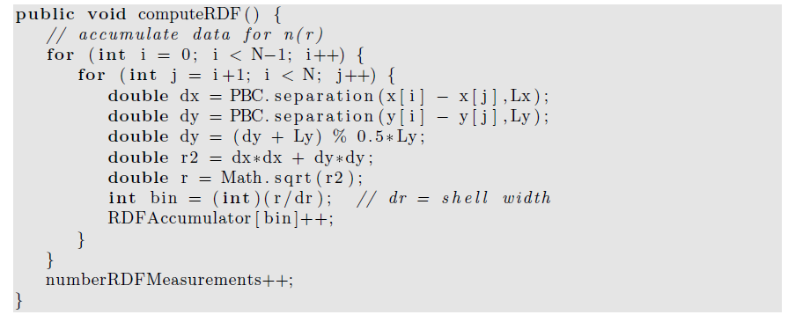
j

Slide 47
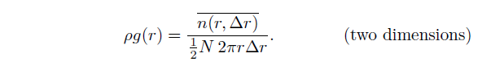
In two dimensions we compute n(r,Δr) for a circular shell whose area is 2πrΔr.
These considerations imply that g(r) is related to n(r) by
Note the factor of N/2 in the denominator. Method normalizeRDF normalizes the array
RDFAccumulator and yields g(r)

Slide 48
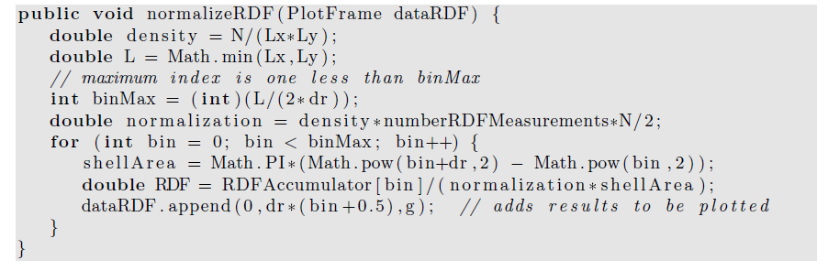
The shell thickness Δr needs to be sufficiently small so that the important features of g(r) are found, but large enough so that each bin has a reasonable number of contributions. The value of Δr should be a class variable. A reasonable choice for its magnitude is Δr = 0.025.

Slide 49
Dynamical Properties
The concept of a collision is not well-defined for systems with a continuous interaction such as the Lennard-Jones potential.
In the following, we take a more general approach to the dynamics of a many body system and discuss how the transport of particles in a system near equilibrium is related to the equilibrium properties of the system.

Slide 50
The trajectory of a particular particle,
for example, particle 1, in a system that is in equilibrium.
At some arbitrarily chosen time t = 0, its position is r1(0).
At a later time t, its displacement is r1(t) − r1(0).

Slide 51
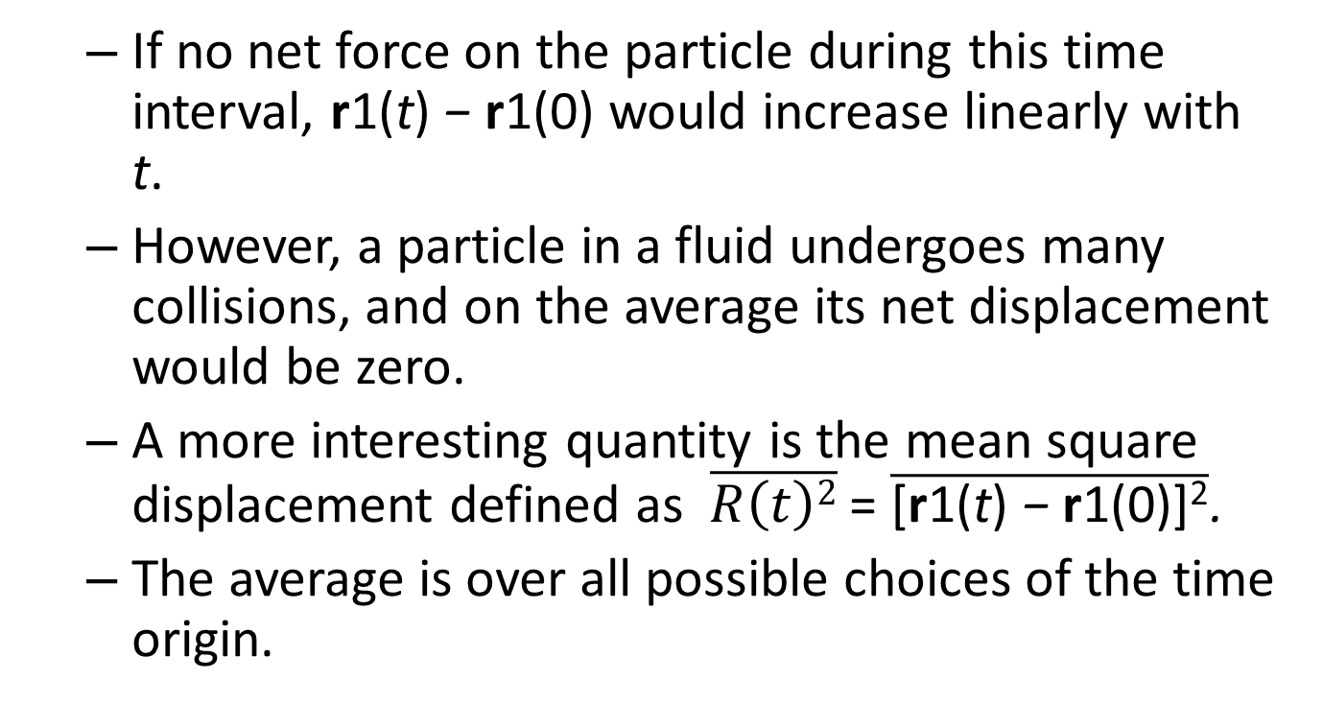
If no net force on the particle during this time interval, r1(t) − r1(0) would increase linearly with t.
However, a particle in a fluid undergoes many collisions, and on the average its net displacement would be zero.
A more interesting quantity is the mean square displacement defined as $\overline{R\left(t\right)2}$ = $\overline{\text{[}\text{r}\text{1(}\text{t}\text{) }\text{− }\text{r}\text{1(0)]}\text{2}}$.
The average is over all possible choices of the time origin.

Slide 52
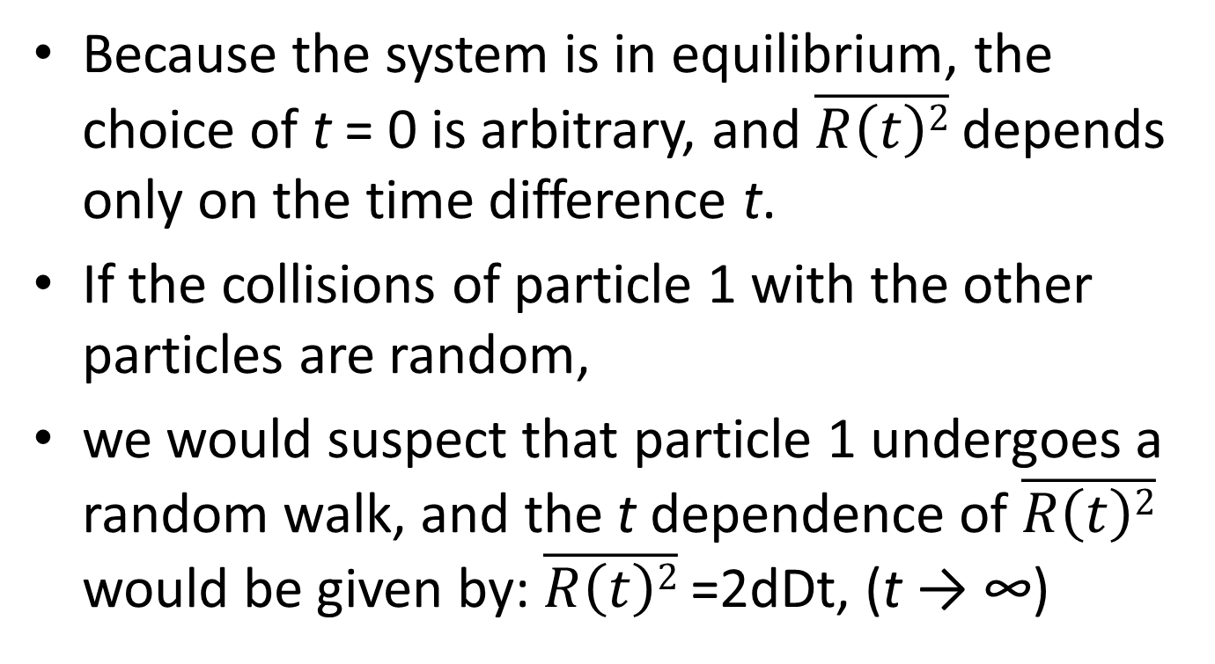
Because the system is in equilibrium, the choice of t = 0 is arbitrary, and $\overline{R\left(t\right)2}$ depends only on the time difference t.
If the collisions of particle 1 with the other particles are random,
we would suspect that particle 1 undergoes a random walk, and the t dependence of $\overline{R\left(t\right)2}$ would be given by: $\overline{R\left(t\right)2}$ =2dDt, (t → ∞)

Slide 53
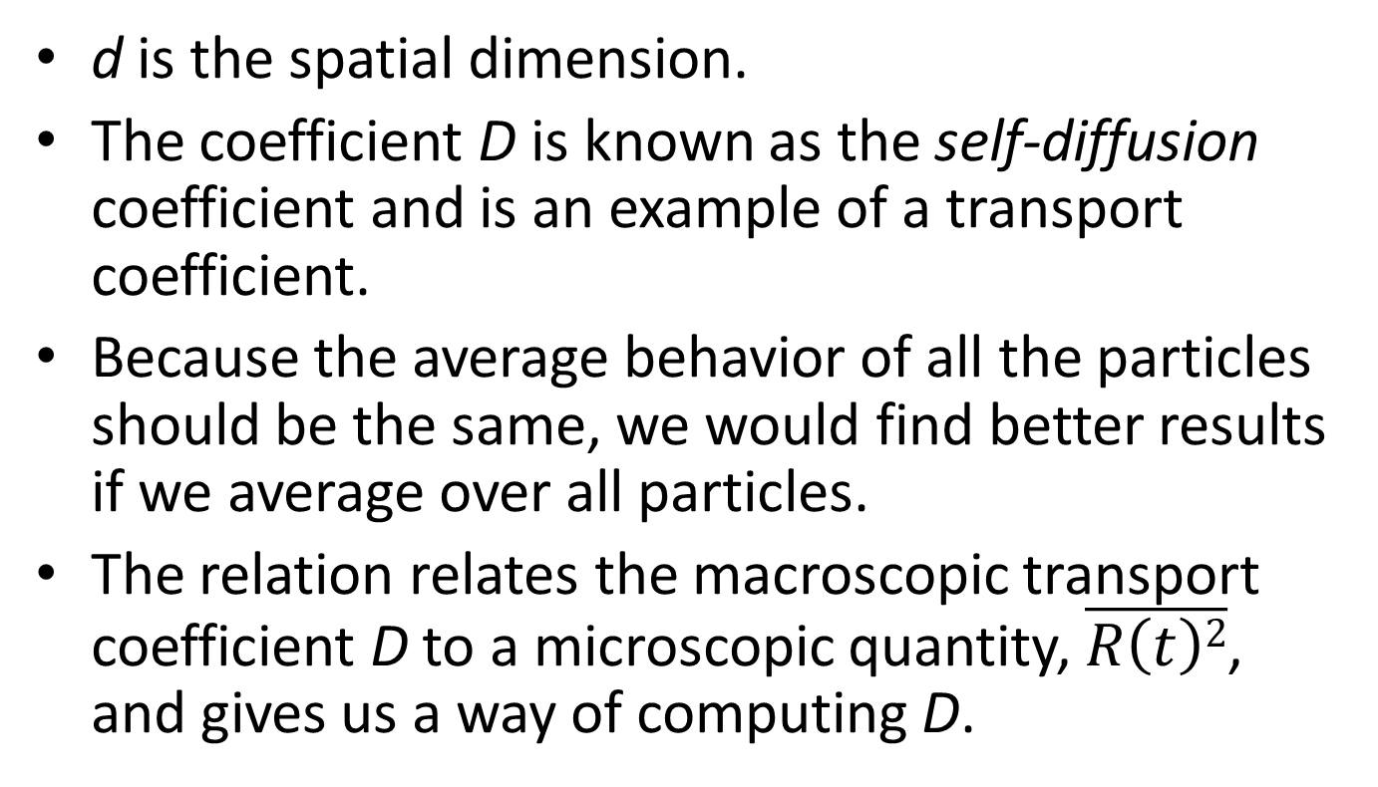
d is the spatial dimension.
The coefficient D is known as the self-diffusion coefficient and is an example of a transport coefficient.
Because the average behavior of all the particles should be the same, we would find better results if we average over all particles.
The relation relates the macroscopic transport coefficient D to a microscopic quantity, $\overline{R\left(t\right)2}$, and gives us a way of computing D.

Slide 54
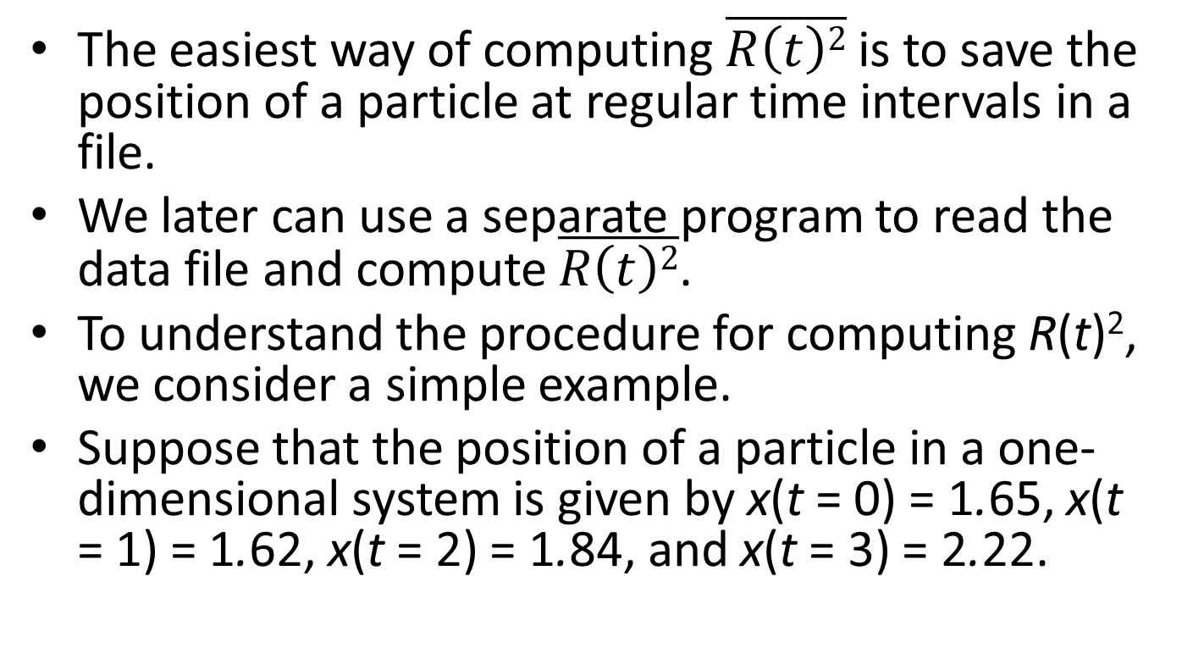
The easiest way of computing $\overline{R\left(t\right)2}$ is to save the position of a particle at regular time intervals in a file.
We later can use a separate program to read the data file and compute $\overline{R\left(t\right)2}$.
To understand the procedure for computing R(t)², we consider a simple example.
Suppose that the position of a particle in a one-dimensional system is given by x(t = 0) = 1.65, x(t = 1) = 1.62, x(t = 2) = 1.84, and x(t = 3) = 2.22.

Slide 55
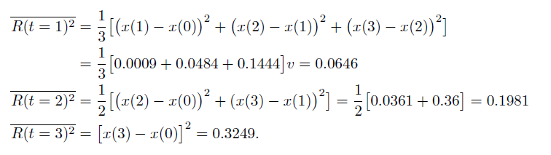
If we average over all possible time origins, we obtain

Slide 56
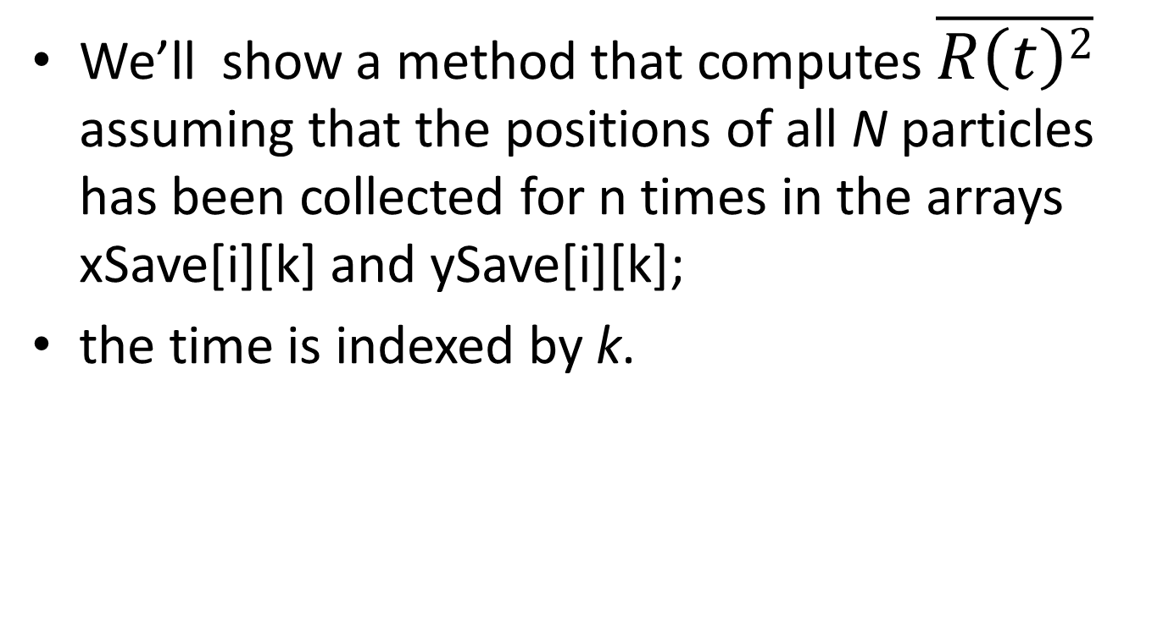
We’ll show a method that computes $\overline{R\left(t\right)2}$ assuming that the positions of all N particles has been collected for n times in the arrays xSave[i][k] and ySave[i][k];
the time is indexed by k.

Slide 57
we cannot find the distance moved by a particle by just keeping track of its position.
Because of periodic boundary conditions,
Imagine that a particle moved in only one direction
and returned to its original position.

Slide 58
If we just subtracted the coordinates of the position,
we would find that the particle’s displacement was zero
when in fact it really moved an amount equal to the length of the simulation cell.
How to solve this problem?

Slide 59
To keep track of the movement of each particle, we use two arrays, xWrap and yWrap.
Every time particle i moves past the right boundary in the time interval k*dk to (k+1)*dk, xWrap[i][k] is incremented by Lx.
Similarly, each time the particle moves past the left boundary xWrap[i][k] is decremented by Lx.
A similar procedure is used for yWrap.

Slide 60
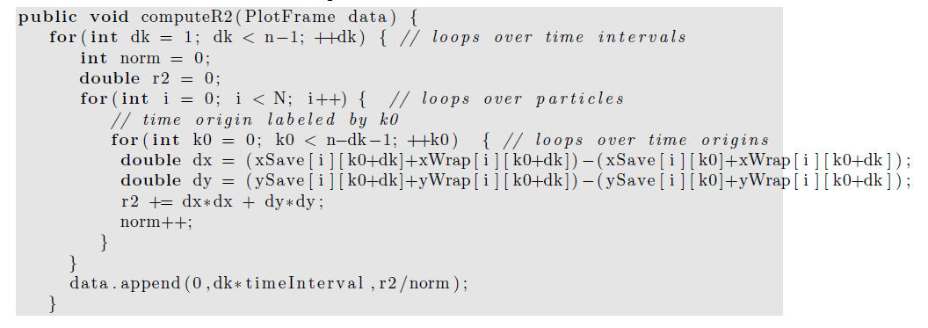
Textbook error!

Slide 61
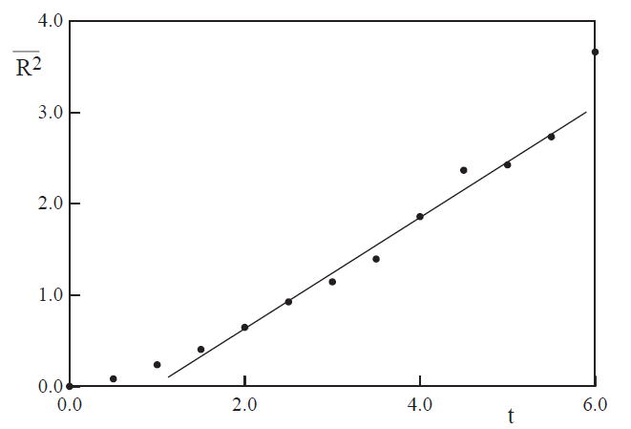
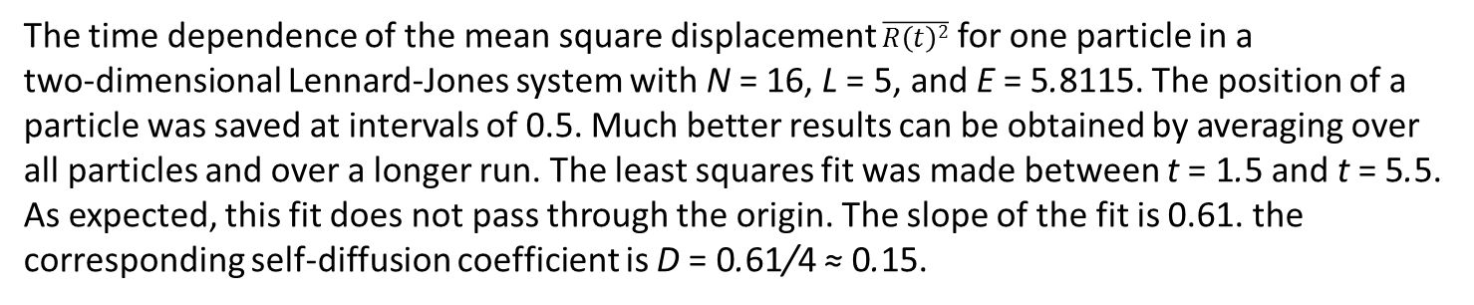
The time dependence of the mean square displacement $\overline{R\left(t\right)2}$ for one particle in a
two-dimensional Lennard-Jones system with N = 16, L = 5, and E = 5.8115. The position of a
particle was saved at intervals of 0.5. Much better results can be obtained by averaging over all particles and over a longer run. The least squares fit was made between t = 1.5 and t = 5.5. As expected, this fit does not pass through the origin. The slope of the fit is 0.61. the
corresponding self-diffusion coefficient is D = 0.61/4 ≈ 0.15.

Slide 62
Another physically important property is the velocity autocorrelation function C(t).
Suppose that particle i has velocity vi at time t = 0.
If there were no net force on particle i, its velocity would remain constant.

Slide 63
However, its interactions with other particles in the fluid will change the particle’s velocity,
and we expect that after several collisions,
its velocity will not be strongly correlated with its velocity at an earlier time.

Slide 64
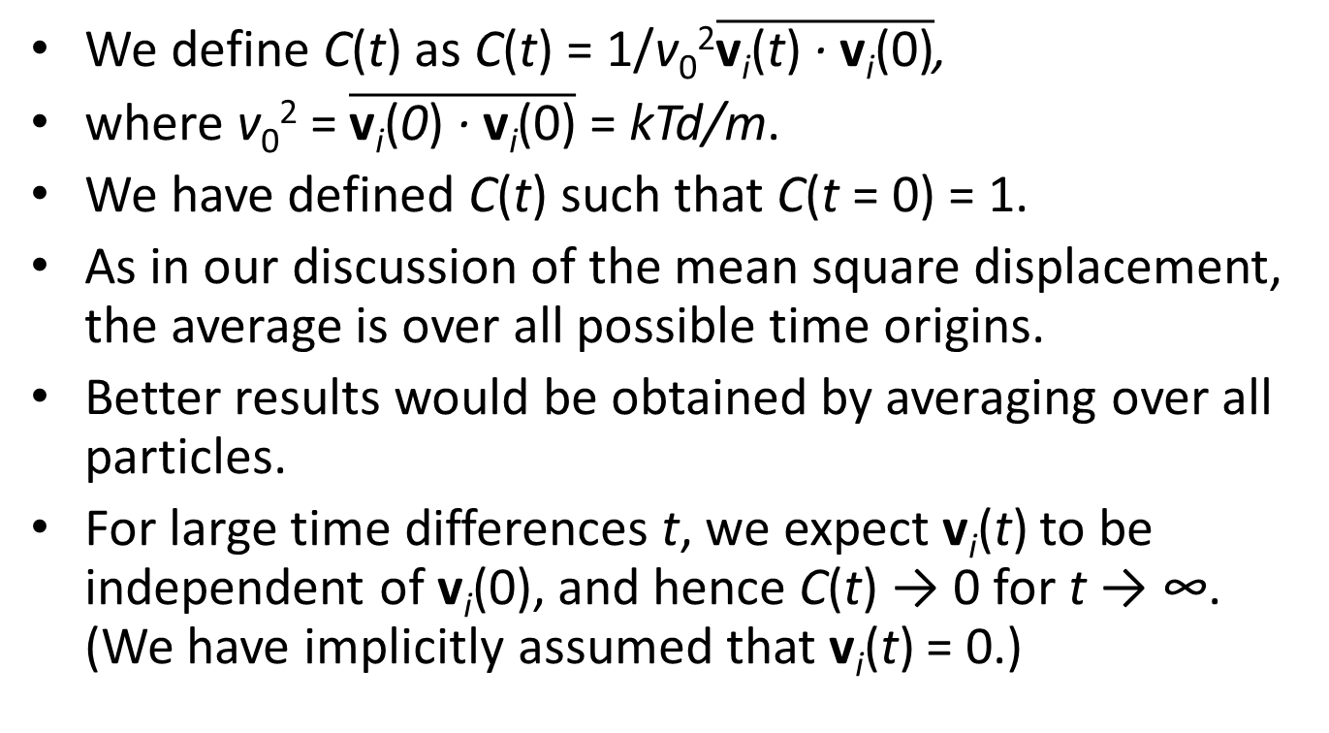
We define C(t) as C(t) = 1/v₀²$\overline{\text{v}\text{i}\text{(}\text{t}\text{) }\text{· }\text{v}\text{i}\text{(0)}}$,
where v₀² = $\overline{\text{v}\text{i}\text{(}\text{0}\text{) }\text{· }\text{v}\text{i}\text{(0)}}$ = kTd/m.
We have defined C(t) such that C(t = 0) = 1.
As in our discussion of the mean square displacement, the average is over all possible time origins.
Better results would be obtained by averaging over all particles.
For large time differences t, we expect v_{i}(t) to be independent of v_{i}(0), and hence C(t) → 0 for t → ∞. (We have implicitly assumed that v_{i}(t) = 0.)

Slide 65
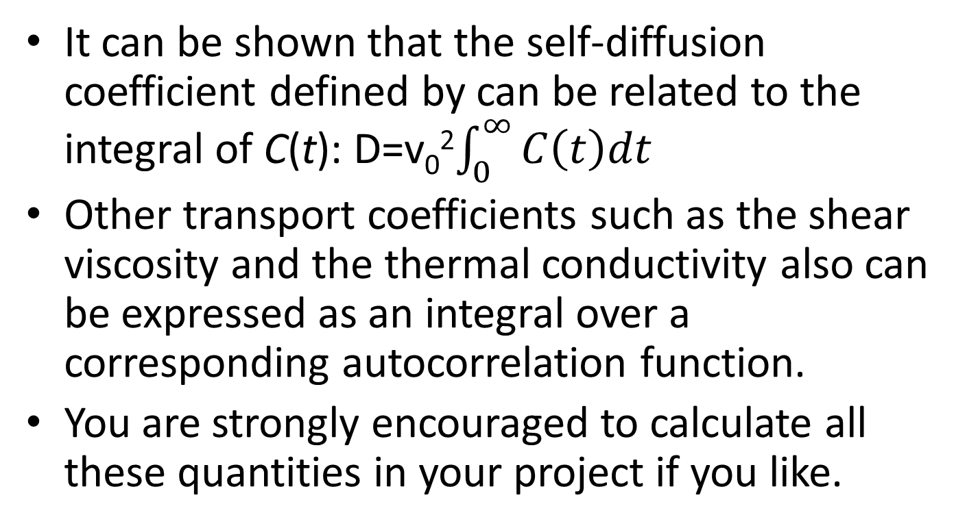
It can be shown that the self-diffusion coefficient defined by can be related to the integral of C(t): D=v₀²$\int_{0}^{∞}{C\left(t\right)dt}$
Other transport coefficients such as the shear viscosity and the thermal conductivity also can be expressed as an integral over a corresponding autocorrelation function.
You are strongly encouraged to calculate all these quantities in your project if you like.

Slide 66
Heat bath
To implement canonical ensemble, we need to fix the temperature.
Also, such practice can largely reduce the error accumulation in Verlet algorithm.

Slide 67
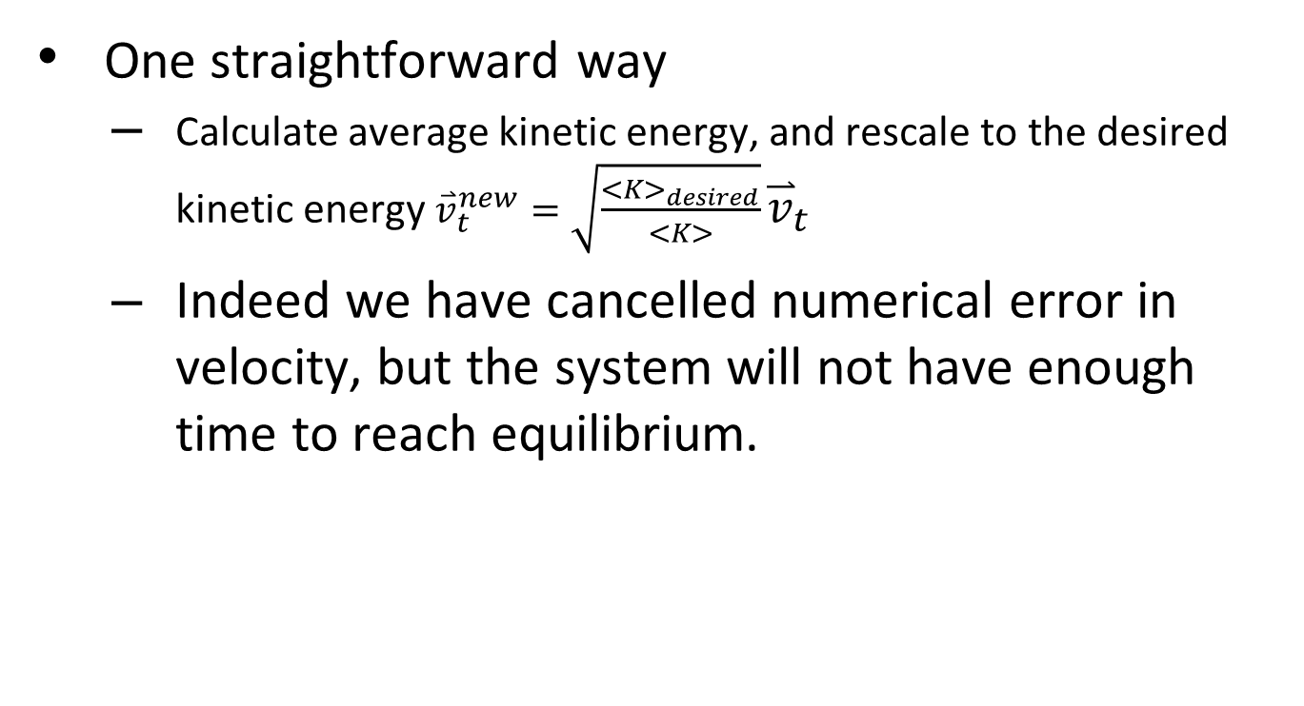
To rescale velocity?
One straightforward way
Calculate average kinetic energy, and rescale to the desired kinetic energy ${\overset{⃑}{v}}_{t}^{new}=\sqrt{\frac{<K>_{desired}}{<K>}}{\overset{⃑}{v}}_{t}$
Indeed we have cancelled numerical error in velocity, but the system will not have enough time to reach equilibrium.

Slide 68
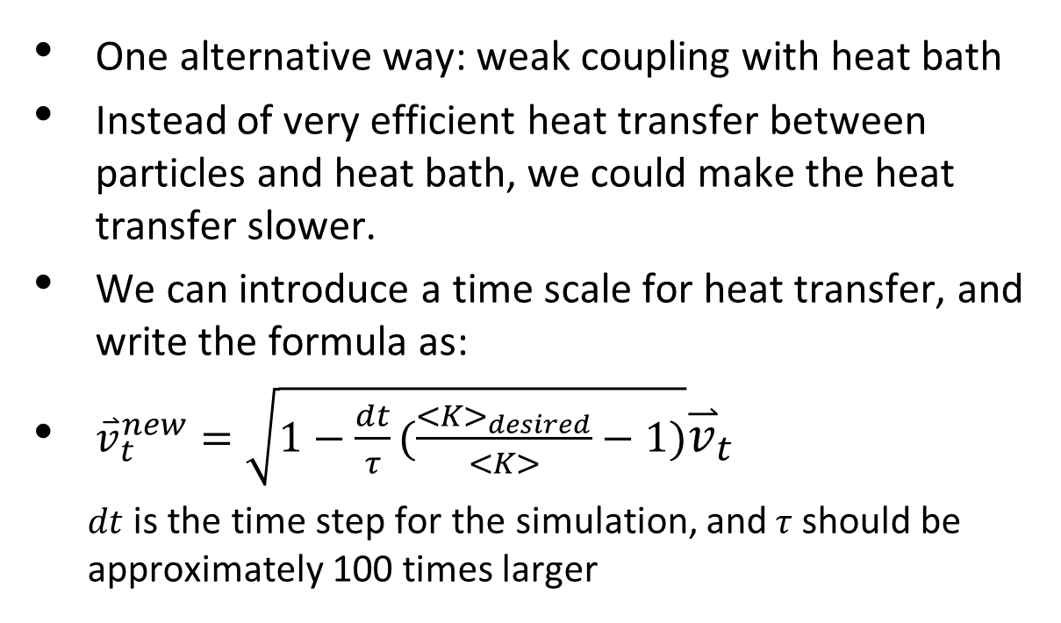
Implementation of heat bath How to rescale velocity?
One alternative way: weak coupling with heat bath
Instead of very efficient heat transfer between particles and heat bath, we could make the heat transfer slower.
We can introduce a time scale for heat transfer, and write the formula as:
${\overset{⃑}{v}}_{t}^{new}=\sqrt{1−\frac{dt}{τ}(\frac{<K>_{desired}}{<K>}−1)}{\overset{⃑}{v}}_{t}$
$dt$ is the time step for the simulation, and$τ$ should be approximately 100 times larger

Slide 69
Oscillations

Slide 70
Simple Harmonic Motion
There are many physical systems that undergo regular, repeating motion.
Motion that repeats itself at definite intervals, for example, the motion of the earth about the sun, is said to be periodic.
Translational symmetry along the time axis.

Slide 71
If an object undergoes periodic motion between two limits over the same path, we call the motion oscillatory.
Examples of oscillatory motion:
a plucked guitar string and the pendulum in a grandfather clock.
Less obvious examples are microscopic phenomena such as the oscillations of the atoms in crystalline solids.

Slide 72
To illustrate the important concepts associated with oscillatory phenomena, consider a block of mass m connected to the free end of a spring.
The block slides on a frictionless, horizontal surface.
We specify the position of the block by x and take x = 0 to be the equilibrium position of the block,
that is, the position when the spring is relaxed.

Slide 73
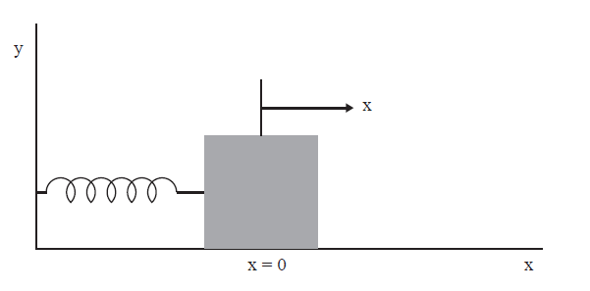
If the block is moved from x = 0 and then released, the block oscillates along a horizontal line.
If the spring is not compressed or stretched too far from x = 0, the force on the block at position x is proportional to x: F = −kx.

Slide 74
The force constant k is a measure of the stiffness of the spring.
The negative sign implies that the force acts to restore the block to its equilibrium position.
Newton’s equation of motion for the block can be written as d²x/dt² = −ω₀²x,
where the angular frequency ω0 is defined by
ω₀² =k/m.

Slide 75
One form of the solution is x(t) = Acos(ω₀t + δ),
where A and δ are constants and the argument of the cosine is in radians.
The constants A and δ are called the amplitude and the phase respectively,
and are determined by the initial conditions for x and the velocity v = dx/dt.

Slide 76
Because the cosine is a periodic function with period 2π,
we know that x(t) also is periodic.
We define the period T as the smallest time for which the motion repeats itself, that is,
x(t + T) = x(t).
Because ω₀T corresponds to one cycle,
we have
T =2π/ω₀=2π / SQRT(k/m)

Slide 77
The frequency ν of the motion is the number of cycles per second and is given by ν = 1/T .
Note that T depends on the ratio k/m and not on A and δ.
Hence the period of simple harmonic motion is independent of the amplitude of the motion.

Slide 78
Although the position and velocity of the oscillator are continuously changing, the total energy
E remains constant and is given by
E =1/2 mv² +1/2 kx² =1/2kA²

Slide 79
The Motion of a Pendulum
A common example of a mechanical system that exhibits oscillatory motion is the simple pendulum.
A simple pendulum is an idealized system consisting of a particle or bob of mass m attached to the lower end of a rigid rod of length L and negligible mass;
the upper end of the rod pivots without friction.
If the bob is pulled to one side from its equilibrium position and released,
the pendulum swings in a vertical plane.

Slide 80
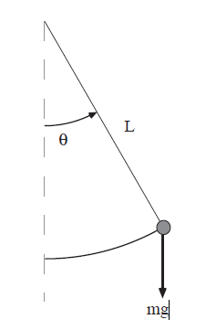
velocity and acceleration of the bob as measured along the arc are given by
v = Ldθ/dt
a = Ld²θ/dt²
In the absence of friction, two forces act on the bob: the force mg vertically downward and the force of the rod which is directed inward to the center if |θ| < π/2.
Note that the effect of the rigid rod is to constrain the motion of the bob along the arc.
We can see that the component of mg along the arc is mg sin θ in the direction of decreasing θ.

Slide 81
Hence, the equation of motion can be written as
(mL) d²θ/dt² = −mg sin θ,
or
d²θ/dt² = − (g/L) sin θ.

Slide 82
an example of a nonlinear equation because sin θ rather than θ appears.
Most nonlinear equations do not have analytical solutions in terms of well-known functions.
However, if the amplitude of the pendulum oscillations is sufficiently small, then sin θ ≈ θ,
d²θ/dt²≈ − (g/L) θ.

Slide 83
the period of a pendulum is given by
T = 2π SQRT(L/g).
Because we know that the numerical solutions must be consistent with conservation of energy,
we derive the form of the total energy here.
The potential energy can be found from the following considerations.
If the rod is deflected by the angle θ, then the bob is raised by the distance h = L−Lcos θ

Slide 84
Hence, the potential energy of the bob in the gravitational field of the earth is
U = mgh = mgL(1 − cos θ),
where the zero of the potential energy corresponds to θ = 0.
Because the kinetic energy of the pendulum is
1/2mv² = 1/2mL²(dθ/dt)²,
the total energy E of the pendulum is
E =1/2mL²(dθ/dt)²+ mgL(1 − cos θ).

Slide 85
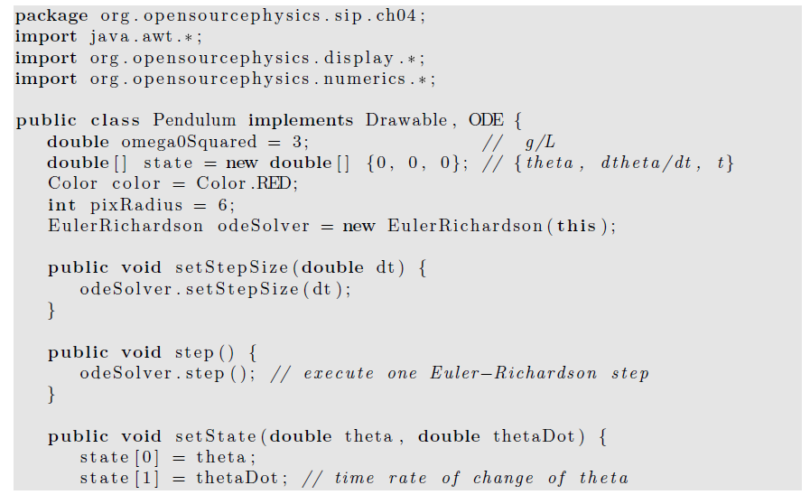

Slide 86
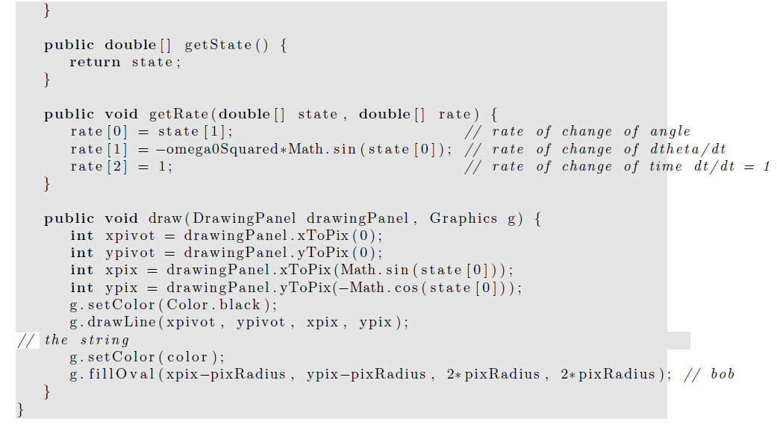

Slide 87
Damped Harmonic Oscillator
We know from experience that most oscillatory motion in nature gradually decreases until the displacement becomes zero; such motion is said to be damped and the system is said to be dissipative rather than conservative.

Slide 88
As an example of a damped harmonic oscillator, consider the motion of the block when a horizontal drag force is included.
For small velocities, it is a reasonable approximation to assume that the drag force is proportional to the first power of the velocity.
In this case the equation of motion can be written as
d²x/dt² = −ω₀²x − γ dx/dt.

Slide 89
The damping coefficient γ is a measure of the magnitude of the drag term.
Note that the drag force opposes the motion.

Slide 90
Response to External Forces
How can we determine the period of a pendulum that is not already in motion?
The obvious way is to disturb the system, for example, to displace the bob and observe its motion.
We will find that the nature of the response of the system to a small perturbation tells us something about the nature of the system in the absence of the perturbation.

Slide 91
Consider the driven damped linear oscillator with an external force F(t) in addition to the linear restoring force and linear damping force.
The equation of motion can be written as
d²x/dt² = −ω₀²x − γv +(1/m)F(t).

Slide 92
It is customary to interpret the response of the system in terms of the displacement x rather than the velocity v.
The time dependence of F(t) is arbitrary.
Because many forces in nature are periodic, we first consider the form
(1/m)F(t) = A₀ cos ωt, where ω is the angular frequency of the driving force.

Slide 93
the response of the damped harmonic oscillator to an external driving force is linear.
For example, if the magnitude of the external force is doubled, then the magnitude of the steady state motion also is doubled.
This behavior is a consequence of the linear nature of the equation of motion.
When a particle is subject to nonlinear forces, the response can be much more complicated.

Slide 94
a phase space plot for a single oscillator.
This plot provides a convenient representation of both the position and velocity.
When we study chaotic phenomena such plots will become almost indispensable.
Here we will consider an important feature of phase space trajectories for conservative systems.

Slide 95
If there are no external forces, the undamped simple harmonic oscillator and undamped pendulum are examples of conservative systems, that is, systems for which the total energy is a constant.
Two general properties of conservative systems:
the nonintersecting nature of their trajectories in phase space and the preservation of area in phase space.
These concepts become more important when we study the properties of conservative systems with more than one degree of freedom.

Slide 96
Electrical Circuit Oscillations
In this section we discuss several electrical analogues of the mechanical systems that we have considered.
Although the equations of motion are similar in form, it is convenient to consider electrical circuits separately, because the nature of the questions of interest is somewhat different.

Slide 97
The starting point for electrical circuit theory is Kirchhoff’s loop rule,
which states that the sum of the voltage drops around a closed path of an electrical circuit is zero.
This law is a consequence of conservation of energy,
because a voltage drop represents the amount of energy that is lost or gained when a unit charge passes through a circuit element.
The relations for the voltage drops across each circuit element are summarized in Table on next page.

Slide 98
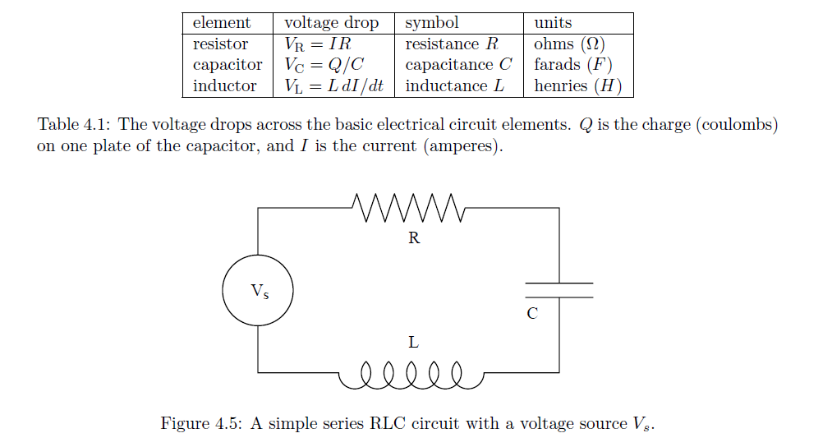

Slide 99
Imagine an electrical circuit with an alternating voltage source V_{s}(t) attached in series to a resistor, inductor, and capacitor.
The corresponding loop equation is V_{L} + V_{R} + V_{C} = V_{s}(t).
L d²Q/dt2 + RdQ/dt+Q/C= Vs(t),
We see that the series RLC circuit is identical in form to the damped harmonic oscillator.
The analogies between ideal electrical circuits and mechanical systems are summarized in Table on next page

Slide 100
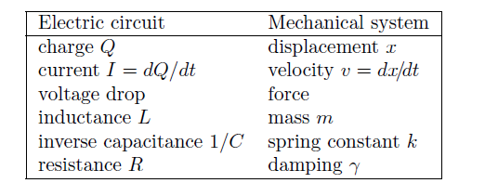

Slide 101
Accuracy and Stability
We have learned how to use numerical methods to find numerical solutions to simple first-order differential equations,
we need to develop some practical guidelines to help us estimate the accuracy of the various methods.

Slide 102
Because we have replaced a differential equation by a difference equation, our numerical solution is not identically equal to the true solution of the original differential equation, except for special cases.
The discrepancy between the two solutions has two causes.
One cause is that computers do not store numbers with infinite precision, but rather to a maximum number of digits that is hardware and software dependent.

Slide 103
As we have seen, Java allows the programmer to distinguish between floating point numbers, that is, numbers with decimal points, and integer numbers.
Arithmetic with numbers represented by integers is exact, but we cannot solve a differential equation using integer arithmetic.
Arithmetic operations involving floating point numbers, such as addition and multiplication, introduce roundoff error.

Slide 104
For example, if a computer only stored floating point numbers to two significant figures, the product 2.1 × 3.2 would be stored as 6.7 rather than 6.72.
The significance of roundoff errors is that they accumulate as the number of mathematical operations increases.
Ideally, we should choose algorithms that do not significantly magnify the roundoff error,
for example, we should avoid subtracting numbers that are nearly the same in magnitude.

Slide 105
The other source of the discrepancy between the true answer and the computed answer is the error associated with the choice of algorithm.
This error is called the truncation error.
A truncation error would exist even on an idealized computer that stored floating point numbers with infinite precision and hence had no roundoff error.

Slide 106
Because the truncation error depends on the choice of algorithm and can be controlled by the programmer, you should be motivated to learn more about numerical analysis and the estimation of truncation errors.
However, there is no general prescription for the best algorithm for obtaining numerical solutions of differential equations.

Slide 107
We will find in later chapters that the various algorithms have advantages and disadvantages,
and the appropriate selection depends on the nature of the solution,
which you might not know in advance, and on your objectives.
How accurate must the answer be?
Over how large an interval do you need the solution?
What kind of computer(s) are you using?
How much computer time and personal time do you have?

Slide 108
In practice, we usually can determine the accuracy of a numerical solution by reducing the value of Δt until the numerical solution is unchanged at the desired level of accuracy.
Of course, we have to be careful not to make Δt too small, because too many steps would be required and the computation time and roundoff error would increase.

Slide 109
In addition to accuracy, another important consideration is the stability of an algorithm.
It might happen that the numerical results are very good for short times, but diverge from the true solution for longer times.
This divergence might occur if small errors in the algorithm are multiplied many times, causing the error to grow geometrically.
Such an algorithm is said to be unstable for the particular problem.

